Slide 1
Birth rate analysis

Slide 2
Team members
2110030031 – SUMEET SHARMA
2110030085 – NARRA MANAS
2110030115 – P. PRITHISH REDDY
2110030190 – K. SAI VARDHAN REDDY
2110030252 – MOHAMAD AFEEF SAYEED

Slide 3
Introduction
The birth rate for a given period is the total number of live human births per 1,000 population divided by the length of the period in years. The birth rate is one of the most important determinants of a country's population growth, potentially impacting policy decisions about the health system, education, and economy. There are different types of birth rate such as crude birth rate, corrected birth rate, general fertility rate, age specific fertility, total fertility rate, gross reproduction rate, net reproduction rate, completed fertility rate, standardized fertility rate and cohort fertility rate.

Slide 4
Problem statement
Birthrates are falling globally. In many countries, COVID-19 has suppressed population growth by causing a decline in births, migration and life expectancy. Even before the pandemic, urbanization was driving population decline. There are several factors such as lifestyle factors, an increase in sexually transmitted diseases, rise in obesity and environmental factors involved in urbanization and urban lifestyle that are affecting fertility and have led to rise in male and female subfertility. Lack of affordable housing, flexible and part-time career posts for women and affordable and publicly funded (free) child care have contributed to the current low fertility/birth rates. Couples/women are delaying starting a family which has led to a true decline in their fertility levels due to ovarian ageing and related reasons leading to reduced chance of conception.

Slide 5
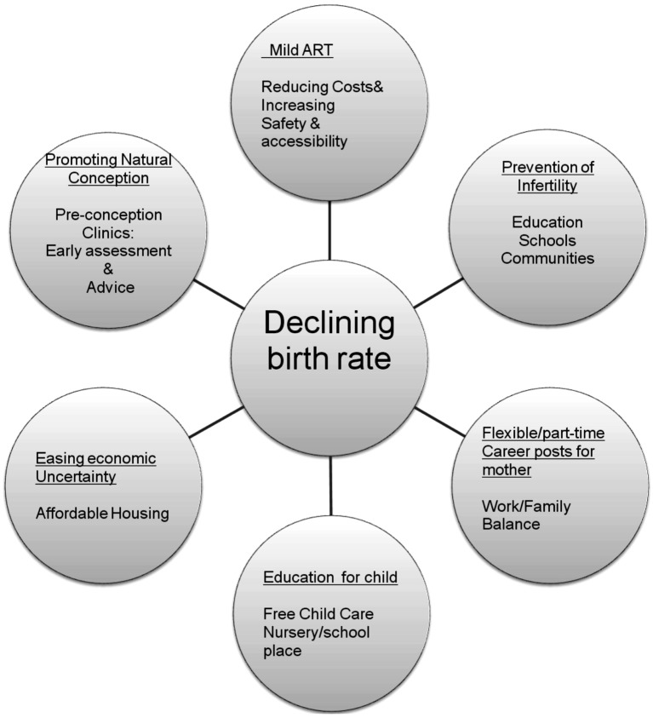

Slide 6
LITERATURE REVIEW
Population ageing is an inevitable outcome of the demographic transition. Primarily, as a result of declines in fertility and, secondarily, mortality declines, the age structure of a population becomes older, with a growing number and proportion of elderly persons. In recent years, the issue of population ageing has received renewed attention in many countries, especially those in the more developed regions, owing to the continuance of fertility below the replacement level and on-going trends towards lower mortality. These changes have profound consequences and far-reaching implications, especially for pension schemes, heath-care systems, education programs and housing plans, as well as for the economic vitality and growth of a country. This chapter reviews selected literature that concerns the impacts of migration on the size and age structure of population. Whereas existing studies have paid a great deal of attention to population ageing and its social and economic implications (see, for instance, United Nations, 2000b; Korea Institute for Health and Social Affairs, 2000; Organization for Economic Cooperation and Development, 1997), the review that follows primarily gathers the literature that investigates the impact of international migration on population dynamics in a low-fertility setting.
Reference - https://www.un.org/en/development/desa/population/publications/pdf/ageing/replacement-chap2.pdf

Slide 7
Dataset collection
Time Series International Database by Single Year of Age and Sex
https://api.census.gov/data/timeseries/idb/1year?get=NAME,AGE,POP,AREA_KM2&GENC=NO&YR=2021&SEX=0

Slide 8
requirements
Python
Dataset

Slide 9

GitHub setup

Slide 10
THANK YOU

